Slide 1



Digital Logic Design
Semester II
FY
Course Code
316U06C203
Jan – May 2026

Slide 2


Combinational Cirucits

Slide 3
Contents
Half and Full Adder,
Half and Full Subtractor,
Four Bit Binary Adder,
Four Bit Binary Subtractor (1’s and 2’s complement method)
Controller Adder / Subtractor
Multiplexers and multiplexer trees,
Decoders
Encoders
One bit, Two-bit ,4-bit Magnitude Comparator

Slide 4
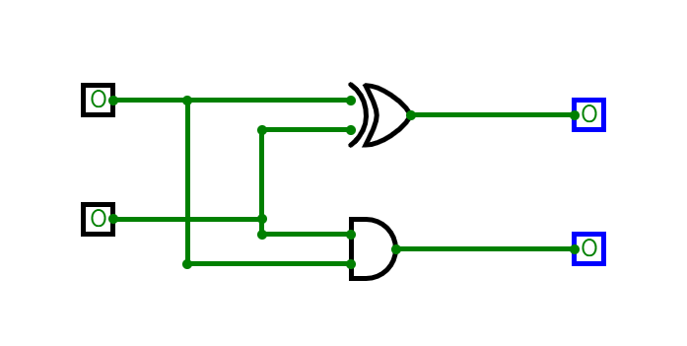
Half Adder
Half adder Truth Table
Half adder
Sum = Σ m (1,2) = A xor B
Carry = Σ m (3) = A and B
A | B | Sum | Cy
0 | 0 | 0 | 0
0 | 1 | 1 | 0
1 | 0 | 1 | 0
1 | 1 | 0 | 1

Slide 5
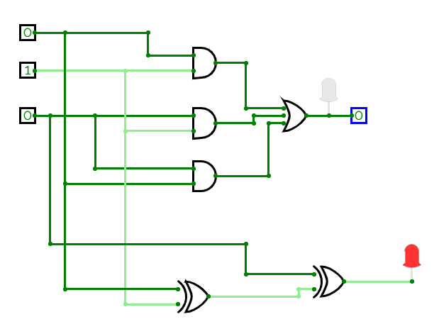
Full Adders
Full adder
Carry = Σ m (3,5,6,7)
= A.B + A.Cin+ B.Cin
Sum = Σ m (1,2,4,7)
= A xor B xor Cin
Full adder Truth Table
A | B | Cin | Sum | Cy
0 | 0 | 0 | 0 | 0
0 | 0 | 1 | 1 | 0
0 | 1 | 0 | 1 | 0
0 | 1 | 1 | 0 | 1
1 | 0 | 0 | 1 | 0
1 | 0 | 1 | 0 | 1
1 | 1 | 0 | 0 | 1
1 | 1 | 1 | 1 | 1

Slide 6
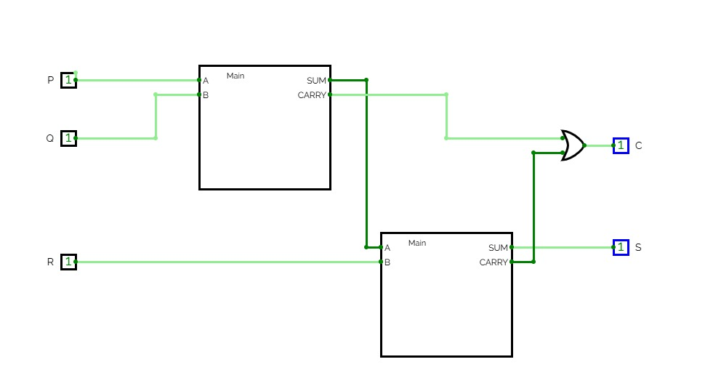
Full Adder using 2 half Adders
Half Adder: Sum = A xor B , Carry = A . B
Full Adder: Sum = A xor B xor Cin, Carry = AB +BCin+ A Cin
Full adder using 2 half adders
Carry = A.B + (A xor B) .Cin
Prove that it is same as AB +BCin+ A Cin

Slide 7
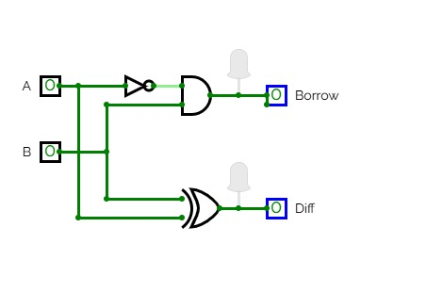
Half Subtractor
Diff = A XOR B , Bo = A’. B
A | B | Diff | Bo
0 | 0 | 0 | 0
0 | 1 | 1 | 1
1 | 0 | 1 | 0
1 | 1 | 0 | 0

Slide 8
Full Subtractor
Full Subtractor
Bout = Σ m (1,2,3,7)
Bout = A’B+ A’Bin + B Bin
Sum = Σ m (1,2,4,7)
= A xor B xor Bin
Full Subtractor Truth Table
A | B | Bin | Diff | Bo
0 | 0 | 0 | 0 | 0
0 | 0 | 1 | 1 | 1
0 | 1 | 0 | 1 | 1
0 | 1 | 1 | 0 | 1
1 | 0 | 0 | 1 | 0
1 | 0 | 1 | 0 | 0
1 | 1 | 0 | 0 | 0
1 | 1 | 1 | 1 | 1
AB/Bin | 00 | 01 | 11 | 10
0 | 0 | 1 | 0 | 0
1 | 1 | 1 | 1 | 0

Slide 9
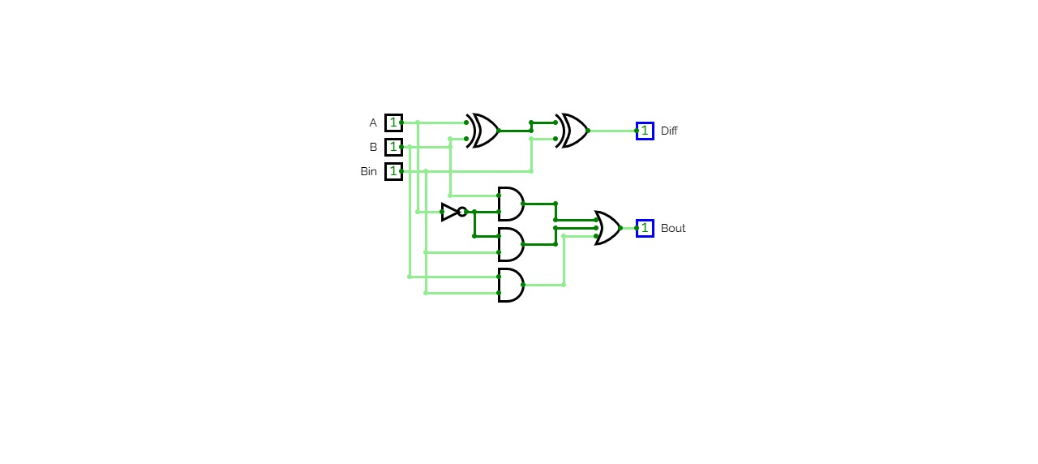
Full Subtractor
Full Subtractor
Bout = Σ m (1,2,3,7)
Bout = A’B+ A’Bin + B Bin
Sum = Σ m (1,2,4,7)
= A xor B xor Bin

Slide 10
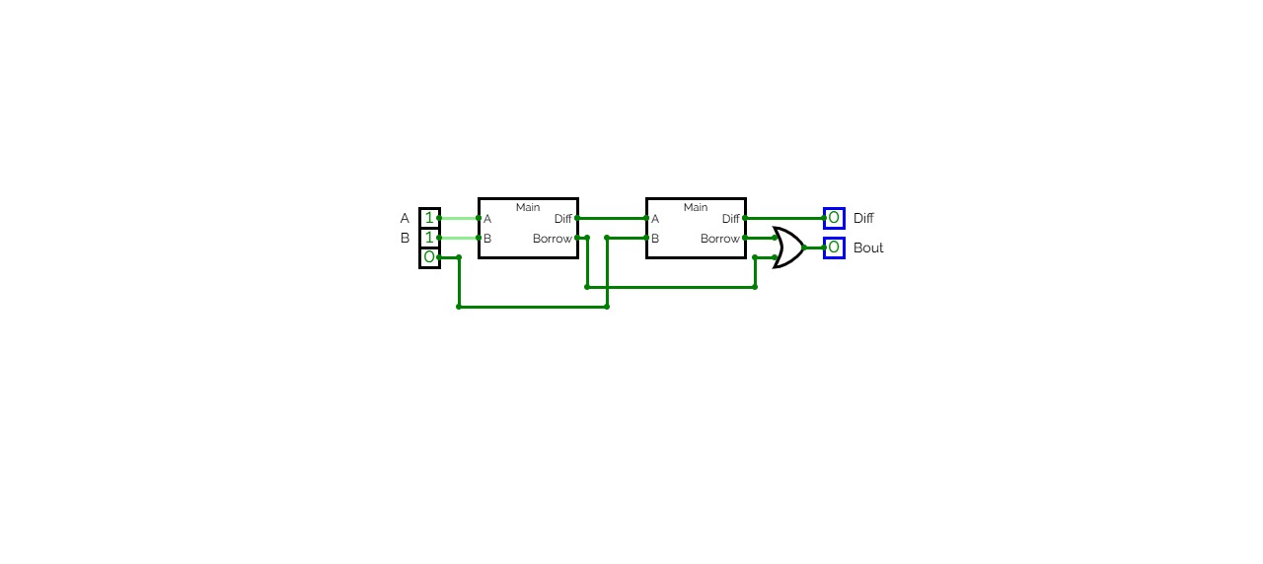
Full Subtractor using Half Subtractors
Diff = A XOR B XOR Bin
Bo =A’B+A’Bin+BBin
Full Subtractor Truth Table
A | B | Bin | Diff | Bo
0 | 0 | 0 | 0 | 0
0 | 0 | 1 | 1 | 1
0 | 1 | 0 | 1 | 1
0 | 1 | 1 | 0 | 1
1 | 0 | 0 | 1 | 0
1 | 0 | 1 | 0 | 0
1 | 1 | 0 | 0 | 0
1 | 1 | 1 | 1 | 1

Slide 11
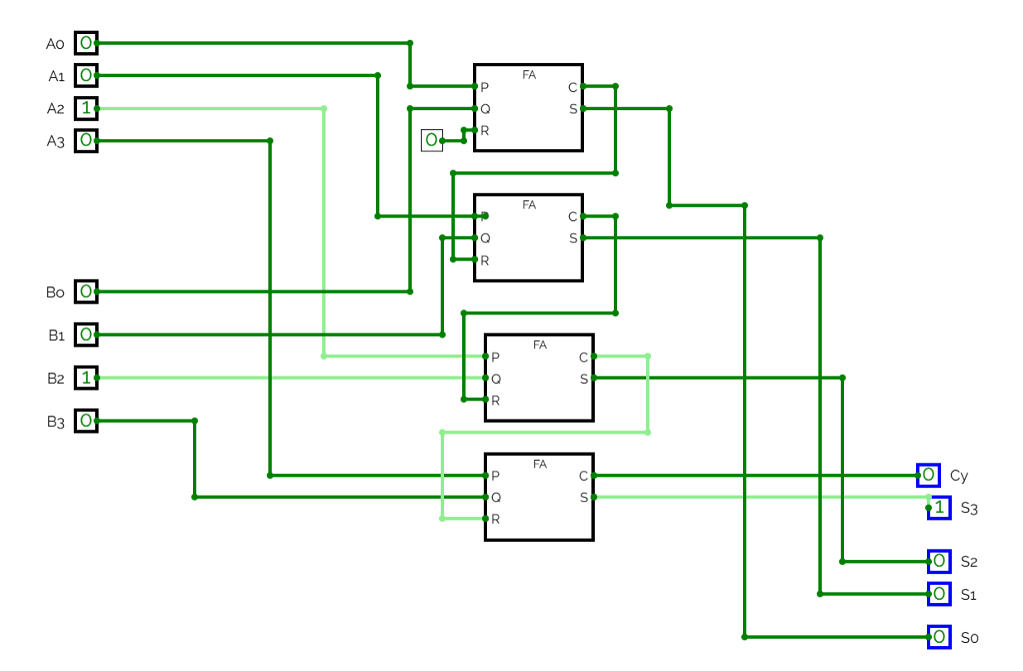
4 bit adder using full Adder

Slide 12
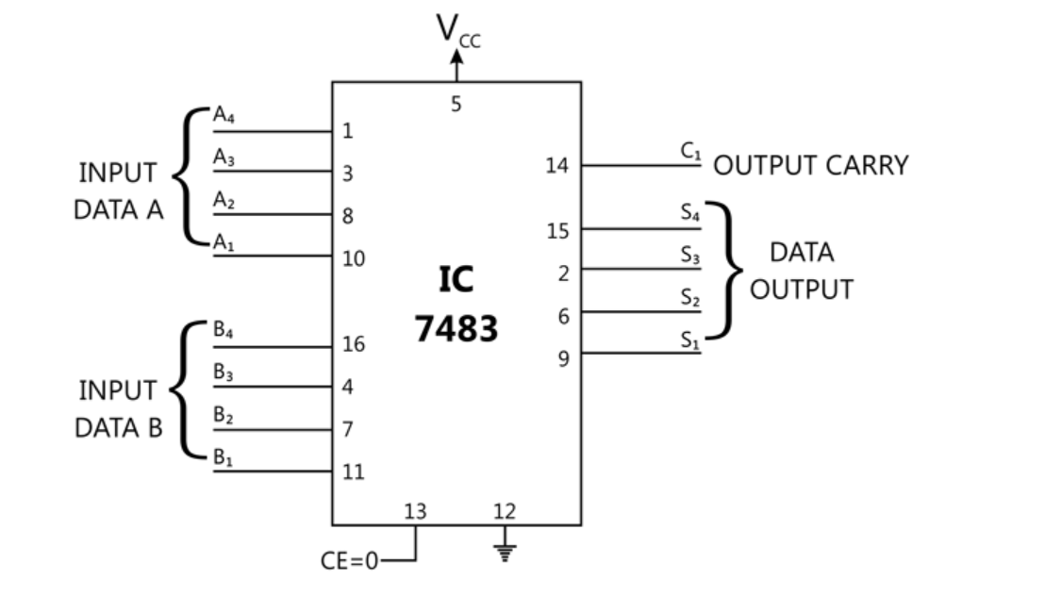
4 bit adder IC 7483

Slide 13
Controlled Adder Subtractor
Circuit which can be Controlled as adder as well as subtractor
If control input C = 0 …Adder
If Control input C = 1 …Subtractor
Addition Subtraction: by 2’s complement
1’s complement of B can be obtained by 4 XOR gates as
1 xor A = A’ , 0 xor A = A
 | A3 | A2 | A1 | A0
+ | B3 | B2 | B1 | B0
C3 | C2 | C1 | C0
Cout | S3 | S2 | S1 | S0
 | A3 | A2 | A1 | A0
+ | B3’ | B2’ | B1’ | B0’
C3 | C2 | C1 | C0 | 1
Cout | S3 | S2 | S1 | S0

Slide 14
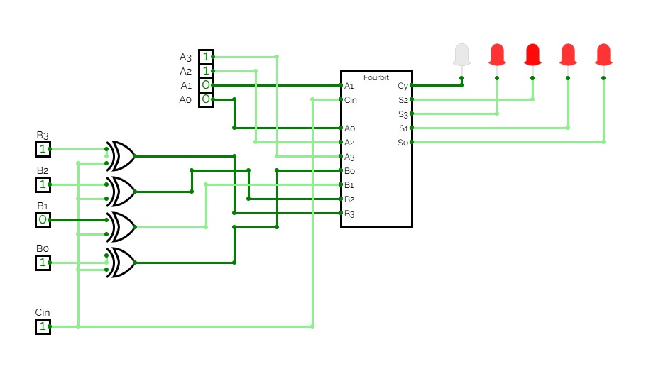
Controlled Adder Subtractor

Slide 15
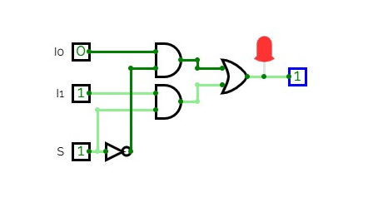
2:1 Multiplexers
Y = S0’.I0 + S0. I1
S0 | Y
0 | I0
1 | I1

Slide 16
4:1 Multiplexers
Y = S0’.I0 + S0. I1

Slide 17
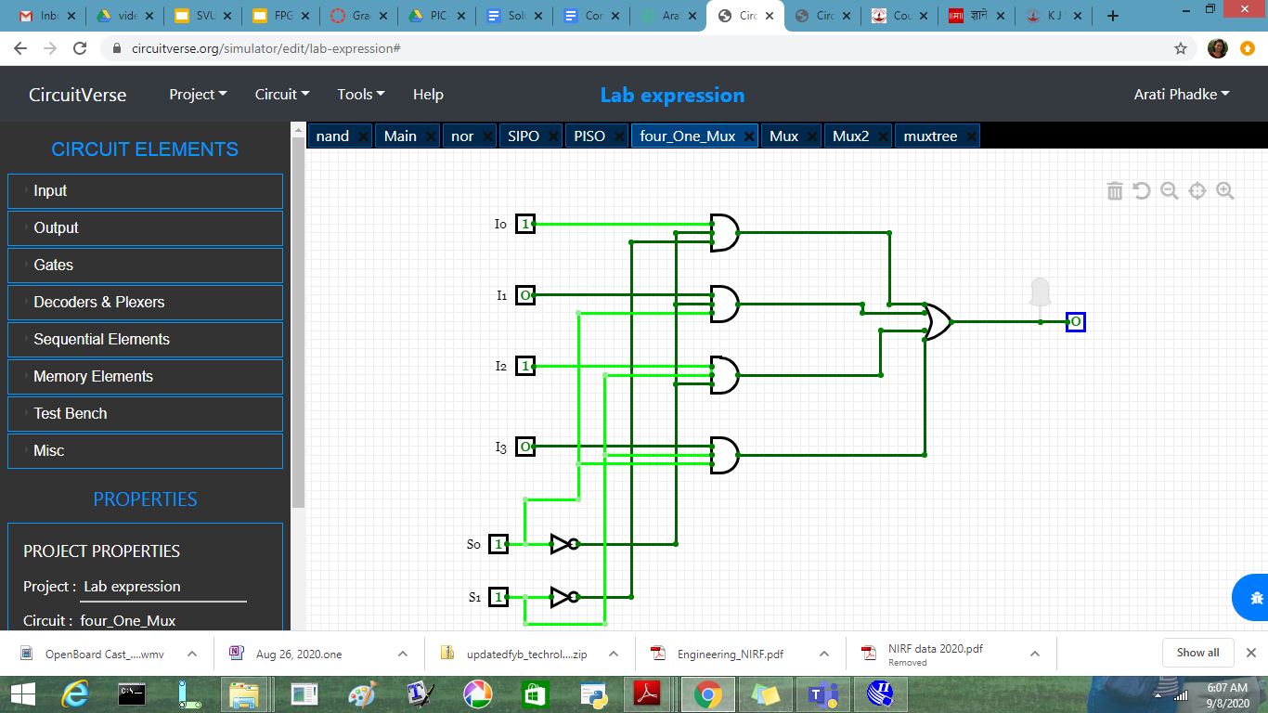
4:1 Multiplexers
4:1 Multiplexer
Y = S1’.S0’.I0 + S1’.S0.I1+S1.S0’.I2+S1.S0.I3
S1 | S0 | Y
0 | 0 | I0
0 | 1 | I1
1 | 0 | I2
1 | 1 | I3

Slide 18
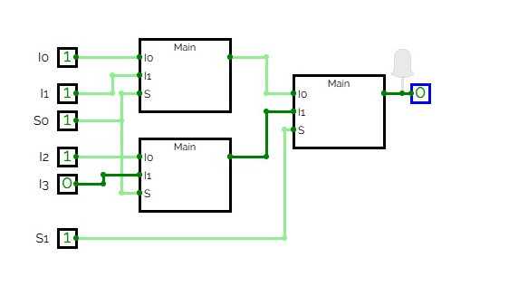
4:1 Multiplexers using 2:1 Mux
4:1 Multiplexer
Y = S1’.S0’.I0 + S1’.S0.I1+S1.S0’.I2+S1.S0.I3
S1 | S0 | Y
0 | 0 | I0
0 | 1 | I1
1 | 0 | I2
1 | 1 | I3

Slide 19
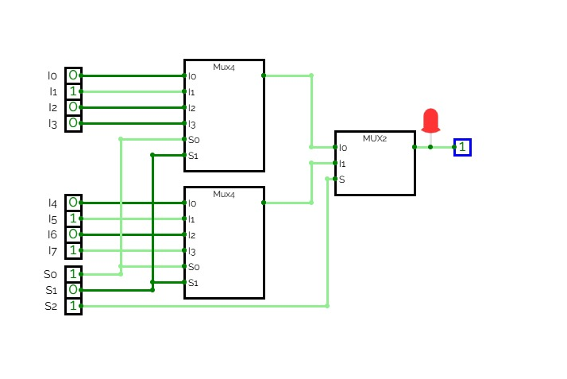
Multiplexer Tree : 8:1 using 4:1 Mux

Slide 20
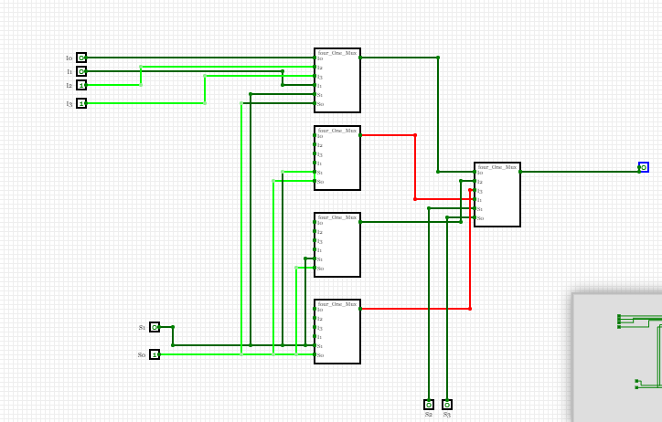
Multiplexer Tree …16:1 using 4:1 Mux

Slide 21
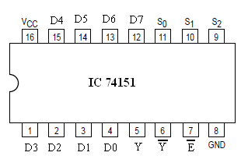
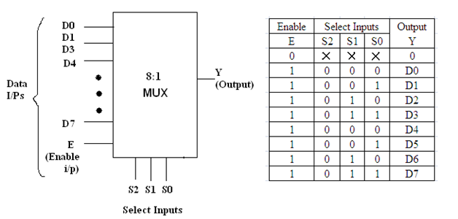
Multiplexers 8:1 : IC 74151

Slide 22
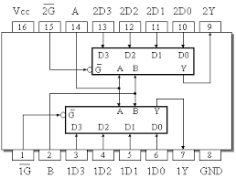
Dual 4:1 Mux IC 74153
Truth Table
Inputs |  |  | Output
B | A | G’ | Y
X | X | 1 | 0
0 | 0 | 0 | D0
0 | 1 | 0 | D1
1 | 0 | 0 | D2
1 | 1 | 0 | D3

Slide 23
Decoder
Truth table Minterm Generator
O0=D1’D0
O1 = D1’D0
O2 = D1D0’
O3 = D1D0
D1 | D0 | O3 | O2 | O1 | O0
0 | 0 | 0 | 0 | 0 | 1
0 | 1 | 0 | 0 | 1 | 0
1 | 0 | 0 | 1 | 0 | 0
1 | 1 | 1 | 0 | 0 | 0

Slide 24
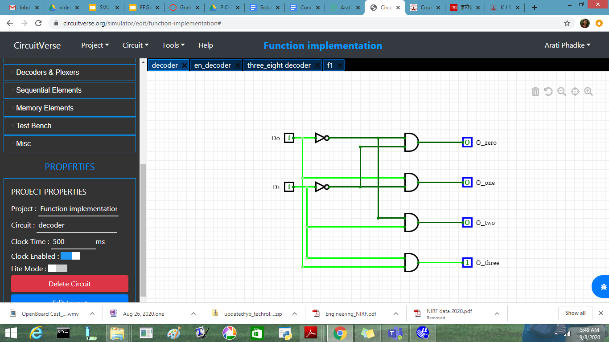
2:4 Decoder

Slide 25
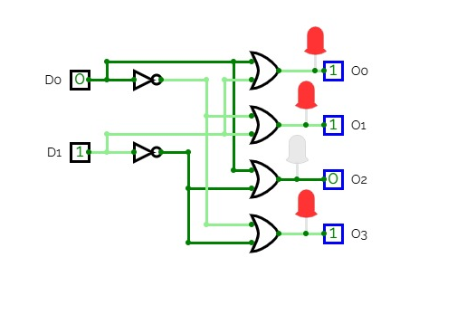
Decoder with active low output
Maxterm Generator
O0= ( D1+D0)
O1 = (D1+D0’)
O2 = (D1’+D0)
O3 = (D1’+D0’)
D1 | D0 | O3 | O2 | O1 | O0
0 | 0 | 1 | 1 | 1 | 0
0 | 1 | 1 | 1 | 0 | 1
1 | 0 | 1 | 0 | 1 | 1
1 | 1 | 0 | 1 | 1 | 1

Slide 26
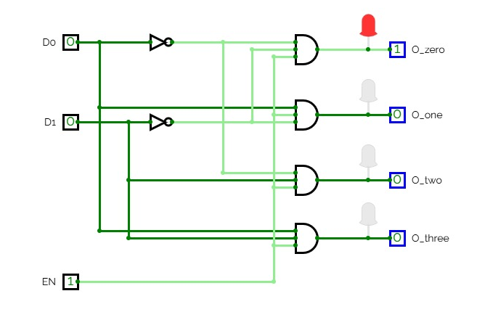
Decoder with enable input
Maxterm Generator
O0= En.D1’D0’
O1 = En.D1’D0
O2 = En.D1D0’
O3 = En.D1D0
En | D1 | D0 | O3 | O2 | O1 | O0
0 | X | X | 0 | 0 | 0 | 0
1 | 0 | 0 | 1 | 1 | 1 | 0
1 | 0 | 1 | 1 | 1 | 0 | 1
1 | 1 | 0 | 1 | 0 | 1 | 1
1 | 1 | 1 | 0 | 1 | 1 | 1

Slide 27
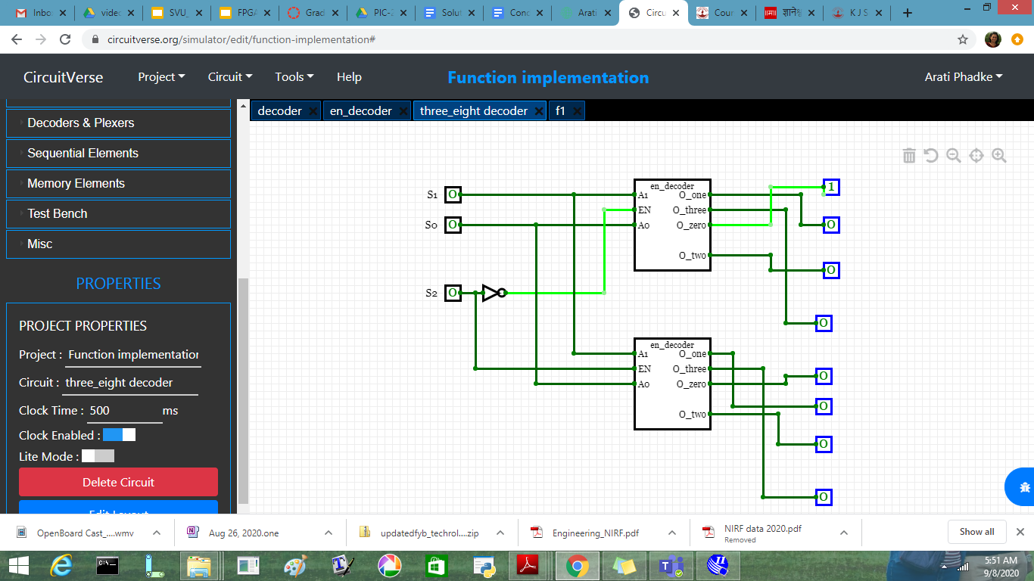
Decoder Tree

Slide 28
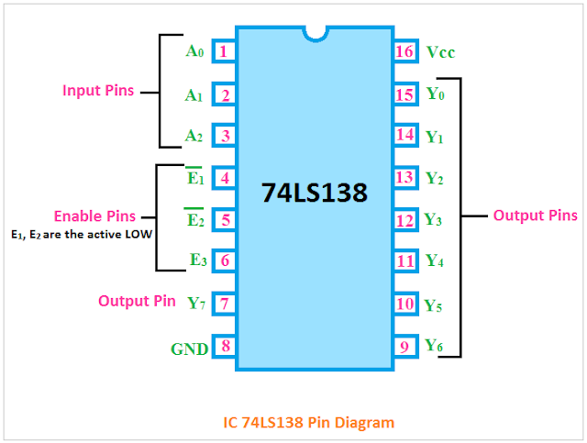
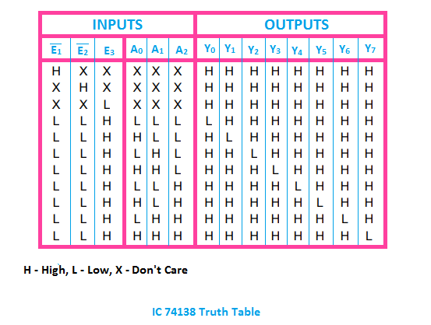
IC 74138: 3:8 Decoder

Slide 29
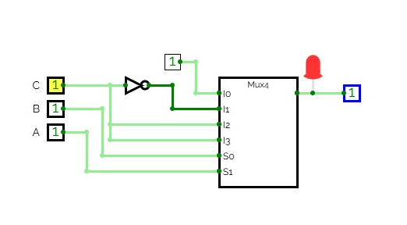
Function Implementation using Multiplexer
F= Σm(0,1,2,5,7)
A | B | C | Y
0 | 0 | 0 | 1 | 1
0 | 0 | 1 | 1
0 | 1 | 0 | 1 | C’
0 | 1 | 1 | 0
1 | 0 | 0 | 0 | C
1 | 0 | 1 | 1
1 | 1 | 0 | 0 | C
1 | 1 | 1 | 1

Slide 30
Function Implementation using Multiplexer
F= Σm(0,2,5,7,8,10,13,15)
Implement using
8: 1 mux
Implement using
4:1 mux
Using 8:1 Mux
ABC are select Lines
A | B | C | D | F
0 | 0 | 0 | 0 | 1 | D’
0 | 0 | 0 | 1 | 0
0 | 0 | 1 | 0 | 1 | D’
0 | 0 | 1 | 1 | 0
0 | 1 | 0 | 0 | 0 | D
0 | 1 | 0 | 1 | 1
0 | 1 | 1 | 0 | 0 | D
0 | 1 | 1 | 1 | 1
A | B | C | D | F
1 | 0 | 0 | 0 | 1 | D’
1 | 0 | 0 | 1 | 0
1 | 0 | 1 | 0 | 1 | D’
1 | 0 | 1 | 1 | 0
1 | 1 | 0 | 0 | 0 | D
1 | 1 | 0 | 1 | 1
1 | 1 | 1 | 0 | 0 | D
1 | 1 | 1 | 1 | 1

Slide 31
Function Implementation using Multiplexer
F= Σm(0,2,5,7,8,10,13,15)
Implement using 4:1 mux
Use select Lines as AB
AB / CD | 00 | 01 | 10 | 11
00 | 1 |  | 1
01 |  | 1 |  | 1
10 | 1 |  | 1
11 |  | 1 |  | 1
 | D’ | D | D’ | D

Slide 32
Function Implementation using Multiplexer
F= Σm(0,1,4,6,8,10,12,15)
Implement using 8: 1 mux
Implement using 4:1 mux
Using 8:1 Mux
ABC are select Lines
A | B | C | D | F
0 | 0 | 0 | 0
0 | 0 | 0 | 1
0 | 0 | 1 | 0
0 | 0 | 1 | 1
0 | 1 | 0 | 0
0 | 1 | 0 | 1
0 | 1 | 1 | 0
0 | 1 | 1 | 1
A | B | C | D | F
1 | 0 | 0 | 0
1 | 0 | 0 | 1
1 | 0 | 1 | 0
1 | 0 | 1 | 1
1 | 1 | 0 | 0
1 | 1 | 0 | 1
1 | 1 | 1 | 0
1 | 1 | 1 | 1

Slide 33
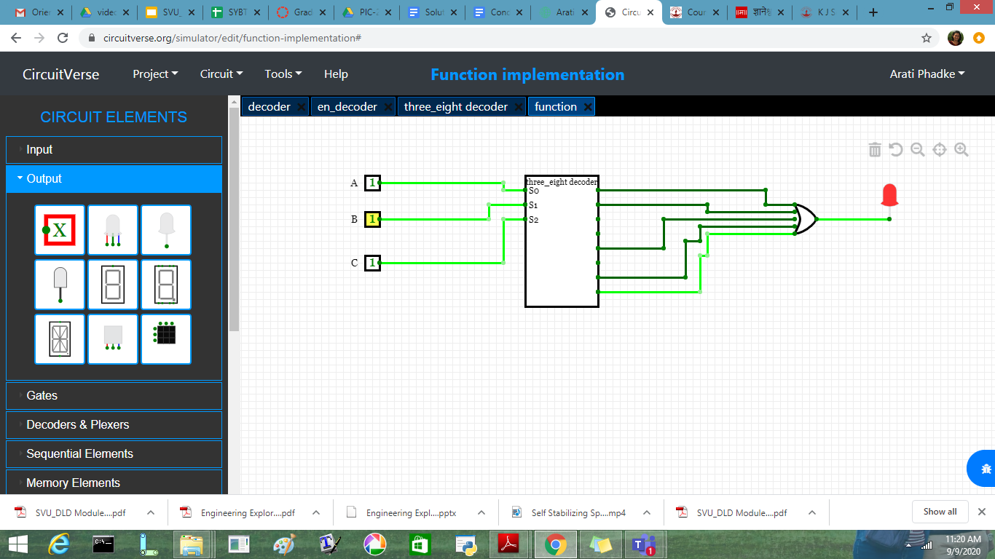
Function Implementation using Decoder
F= Σm(0,1,4,6, 7)
Implement using 3: 8 decoder( Active High Output)

Slide 34
Function Implementation using Decoder
F= Σm(0,1,4,6,8,10,12,15)
Implement 4: 16 decoder

Slide 35
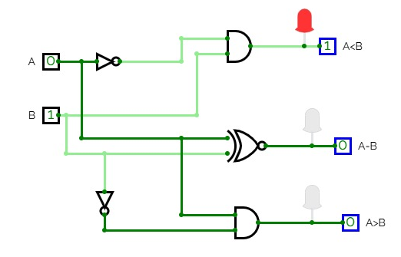
1 bit Comparator
(A<B) = A’B
( A=B) = A XNOR B
(A>B) = AB’
A | B | A<B | A=B | A>B
0 | 0 | 0 | 1 | 0
0 | 1 | 1 | 0 | 0
1 | 0 | 0 | 0 | 1
1 | 1 | 0 | 1 | 0

Slide 36
2 bit Comparator
A1 | A0 | B1 | B0 | A<B | A=B | A>B
0 | 0 | 0 | 0 | 0 | 1 | 0
0 | 0 | 0 | 1 | 1 | 0 | 0
0 | 0 | 1 | 0 | 1 | 0 | 0
0 | 0 | 1 | 1 | 1 | 0 | 0
0 | 1 | 0 | 0 | 0 | 0 | 1
0 | 1 | 0 | 1 | 0 | 1 | 0
0 | 1 | 1 | 0 | 1 | 0 | 0
0 | 1 | 1 | 1 | 1 | 0 | 0
A1 | A0 | B1 | B0 | A<B | A=B | A>B
1 | 0 | 0 | 0 | 0 | 0 | 1
1 | 0 | 0 | 1 | 0 | 0 | 1
1 | 0 | 1 | 0 | 0 | 1 | 0
1 | 0 | 1 | 1 | 1 | 0 | 0
1 | 1 | 0 | 0 | 0 | 0 | 1
1 | 1 | 0 | 1 | 0 | 0 | 1
1 | 1 | 1 | 0 | 0 | 0 | 1
1 | 1 | 1 | 1 | 0 | 1 | 0

Slide 37
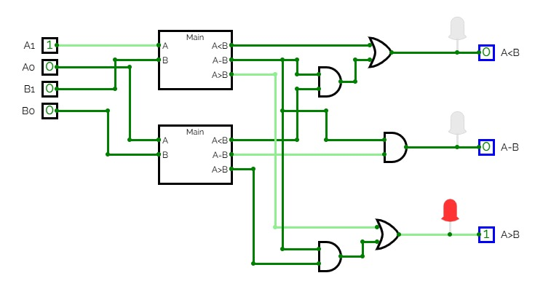
2 bit Comparator

Slide 38
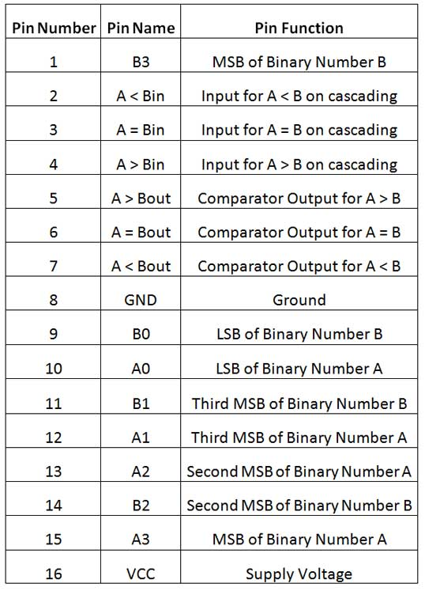
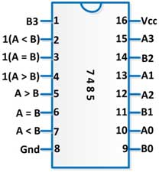
4 bit Comparator
IC 7485 comparator

Slide 39
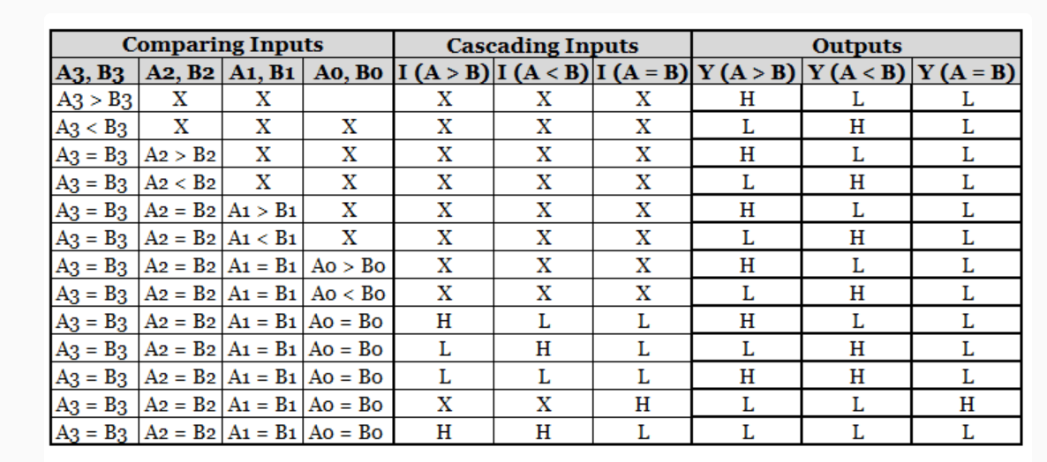
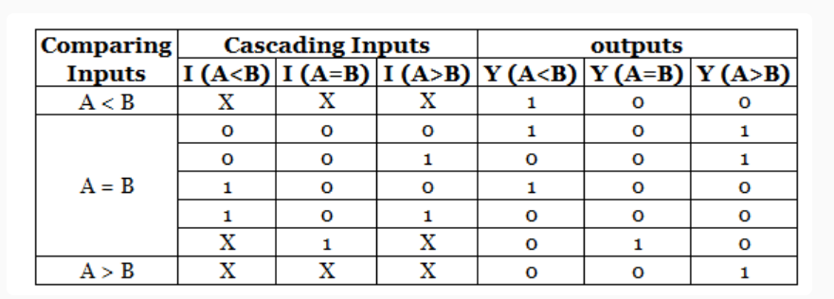
4 bit Comparator

